Slide 1
Random Forest
Eg algorithm for bagging

Slide 2
What Is Random Forest?
Random forest algorithm is a supervised classification and regression algorithm. As the name suggests, this algorithm randomly creates a forest with several trees.
Generally, the more trees in the forest the more robust the forest looks like. Similarly, in the random forest classifier, the higher the number of trees in the forest, greater is the accuracy of the results.

Slide 3
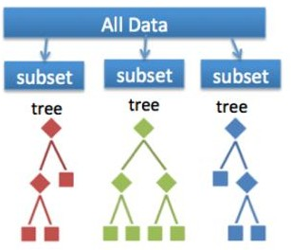
Bootstrap samples
Notes:
Random feature subsets

Slide 4
The random forest algorithm is actually a bagging algorithm: also here, we draw random bootstrap samples from your training set. However, in addition to the bootstrap samples, we also draw random subsets of features for training the individual trees; in bagging, we provide each tree with the full set of features. Due to the random feature selection, the trees are more independent of each other compared to regular bagging, which often results in better predictive performance (due to better variance-bias trade-offs), and I’d say that it’s also faster than bagging, because each tree learns only from a subset of features.

Slide 5
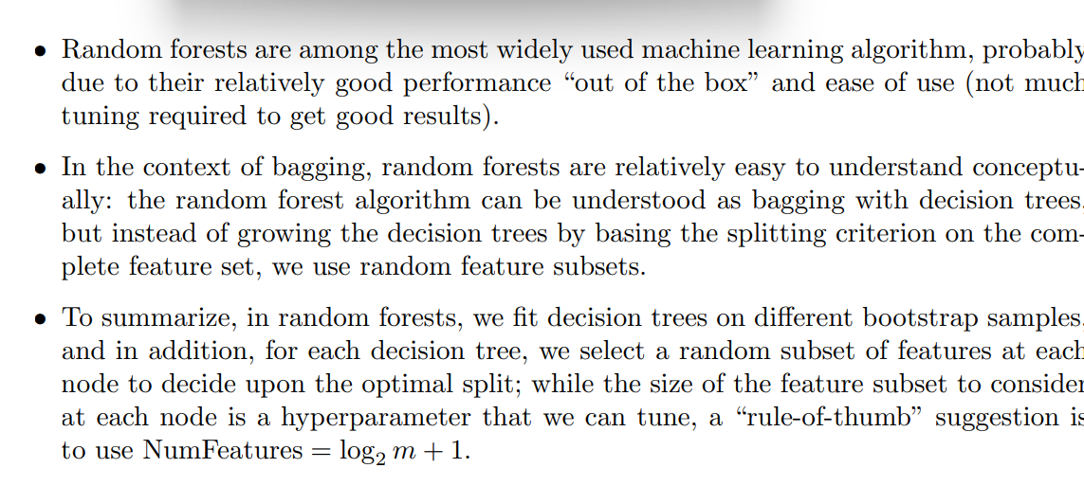

Slide 6
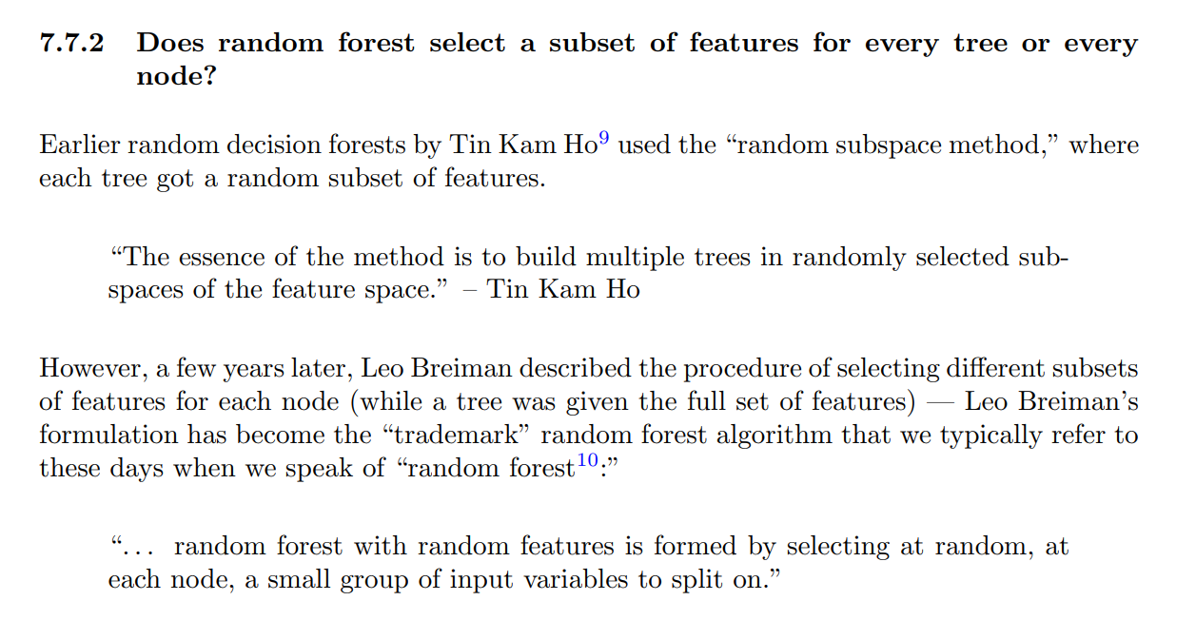

Slide 7
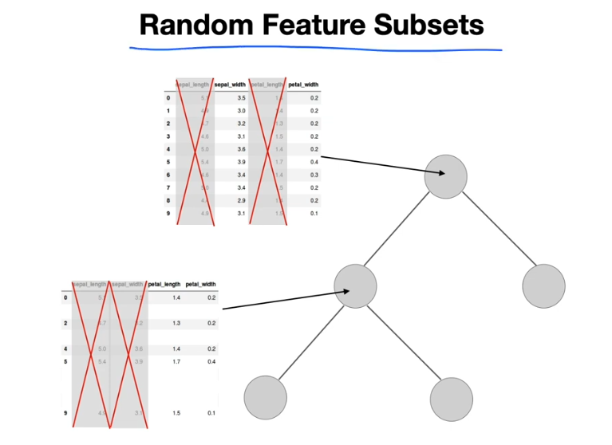

Slide 8
Let’s say that you’re looking to buy a house, but you’re unable to decide which one to buy. So, you consult a few agents and they give you a list of parameters that you should consider before buying a house. The list includes:
Price of the house
Locality
Number of bedrooms
Parking space
Available facilities
These parameters are known as predictor variables, which are used to find the response variable. Here’s a diagrammatic illustration of how you can represent the above problem statement using a decision tree.

Slide 9
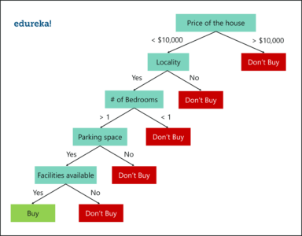

Slide 10
An important point to note here is that Decision trees are built on the entire data set, by making use of all the predictor variables.
Now let’s see how Random Forest would solve the same
problem.
Like I mentioned earlier Random forest is an ensemble of decision trees, it randomly selects a set of parameters and creates a decision tree for each set of chosen parameters.

Slide 11
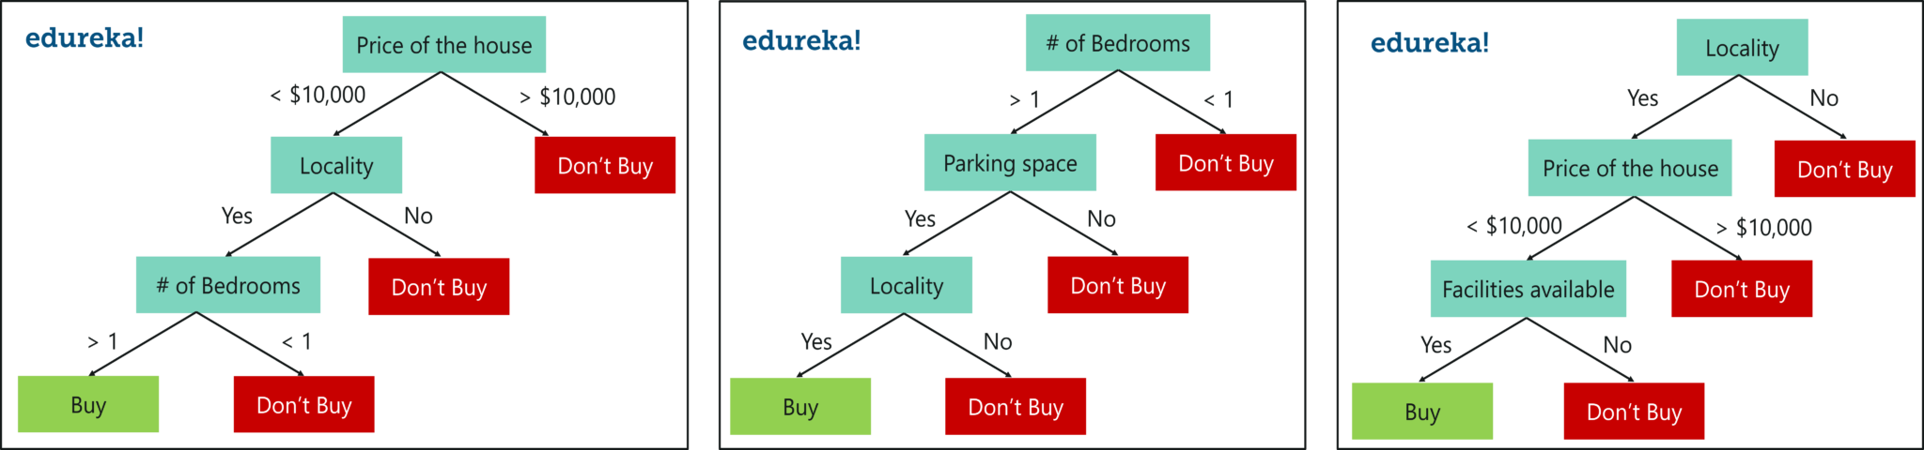

Slide 12
Here, I’ve created 3 Decision Trees and each Decision Tree is taking only 3 parameters from the entire data set. Each decision tree predicts the outcome based on the respective predictor variables used in that tree and finally takes the average of the results from all the decision trees in the random forest.
In simple words, after creating multiple Decision trees using this method, each tree selects or votes the class (in this case the decision trees will choose whether or not a house is bought), and the class receiving the most votes by a simple majority is termed as the predicted class.
To conclude, Decision trees are built on the entire data set using all the predictor variables, whereas Random Forests are used to create multiple decision trees, such that each decision tree is built only on a part of the data set.

Slide 13
Why Use Random Forest?
You might be wondering why we use Random Forest when we can solve the same problems
using Decision trees. Let me explain.
Even though Decision trees are convenient and easily implemented, they lack accuracy.
Decision trees work very effectively with the training data that was used to build them, but
they’re not flexible when it comes to classifying the new sample. Which means that the
accuracy during testing phase is very low.
This happens due to a process called Over-fitting.
Over-fitting occurs when a model studies the training data to such an extent that it negatively influences the performance of the model on new data.
This means that the disturbance in the training data is recorded and learned as concepts by
the model. But the problem here is that these concepts do not apply to the testing data and
negatively impact the model’s ability to classify the new data, hence reducing the accuracy on
the testing data.
This is where Random Forest comes in. It is based on the idea of bagging, which is used to
reduce the variation in the predictions by combining the result of multiple Decision trees on different samples of the data set.

Slide 14
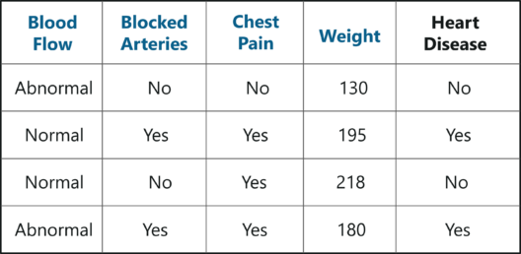
How Does Random Forest Work?
To understand Random forest, consider the below sample data set. In this data set we have four predictor variables, namely:
These variables are used to predict whether or not a person has heart disease. We’re going to use this data set to create a Random Forest that predicts if a person has heart disease or not.

Slide 15
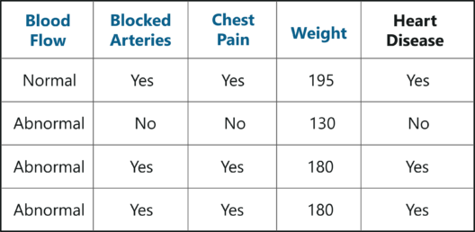
Creating A Random Forest
Step 1: Create a Bootstrapped Data Set
Bootstrapping is an estimation method used to make predictions on a data set by re-sampling it. To create a bootstrapped data set, we must randomly select samples from the original data set. A point to note here is that we can select the same sample more than once.

Slide 16
In the above figure, I have randomly selected samples from the original data set and created a bootstrapped data set.
Simple, isn’t it? Well, in real-world problems you’ll never get
such a small data set, thus creating a bootstrapped data set is a little more complex.

Slide 17
Step 2: Creating Decision Trees
Our next task is to build a Decision Tree by using the bootstrapped data set
created in the previous step. Since we’re making a Random Forest we will not
consider the entire data set that we created, instead we’ll only use a random
subset of variables at each step.
In this example, we’re only going to consider two variables at each step. So,
we begin at the root node, here we randomly select two variables as
candidates for the root node.
Let’s say we selected Blood Flow and Blocked arteries. Out of these 2
variables, we must now select the variable that best separates the samples.
For the sake of this example, let’s say that Blocked Arteries is a more
significant predictor and thus assign it as the root node.
Our next step is to repeat the same process for each of the upcoming branch
nodes. Here, we again select two variables at random as candidates for the
branch node and then choose a variable that best separates the samples.

Slide 18
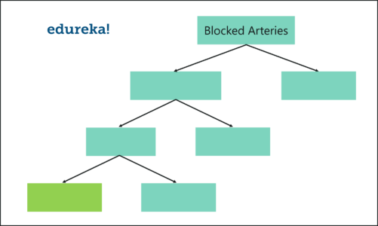
Just like this, we build the tree by only considering random subsets of variables at each step. By following the above process, our tree would look something like this:

Slide 19
Step 3: Go back to Step 1 and Repeat
Like I mentioned earlier, Random Forest is a collection of Decision
Trees. Each Decision Tree predicts the output class based on the
respective predictor variables used in that tree. Finally, the
outcome of all the Decision Trees in a Random Forest is recorded
and the class with the majority votes is computed as the output class.
Thus, we must now create more decision trees by considering a
subset of random predictor variables at each step. To do this, go back to step 1, create a new bootstrapped data set and then build
a Decision Tree by considering only a subset of variables at each
step. So, by following the above steps, our Random Forest would look something like this:

Slide 20
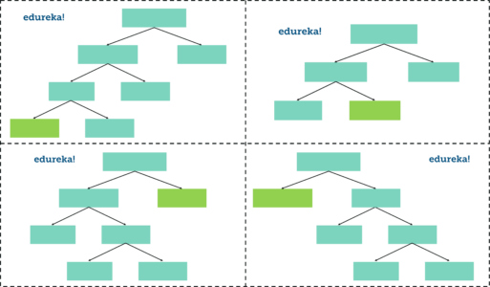

Slide 21
This iteration is performed 100’s of times, therefore creating multiple decision trees with each tree computing the output, by using a subset of randomly selected variables at each step.
Having such a variety of Decision Trees in a Random Forest is what makes it more effective than an individual Decision Tree created using all the features and the whole data set.

Slide 22
Step 4: Predicting the outcome of a new data point
Now that we’ve created a random forest, let’s see how it can be used to predict whether a new patient has heart disease or not.
The below diagram has the data about the new patient. All
we have to do is run this data down the decision trees that we made.
The first tree shows that the patient has heart disease, so we keep a track of that in a table as shown in the figure.

Slide 23
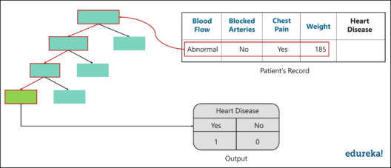

Slide 24
Similarly, we run this data down the other decision trees and keep a track of the class predicted by each tree. After running the data down all the trees in the Random Forest, we check which class got the majority votes. In our case, the class ‘Yes’ received the most number of votes, hence it’s clear that the new patient has heart disease.
To conclude, we bootstrapped the data and used the aggregate from all the trees to make a decision, this process is known as Bagging.

Slide 25
Reference
Complete Tutorial On Random Forest In R With Examples | Edureka

